Slide 1
BTECH CSE IOT
FINAL YEAR PROJECT
ParcelVault – A Secure IoT-Based Smart Delivery Box
Enhancing Last-Mile Delivery with Cloud Integration
Yaovi Joel Djatassiba
Mlaaz Elbadri
Herve Claudel Ineza
Amara A. Kamara
-
-
-
-
21BTRCO055
21BTRCO043
21BTRCO044
2BTRCO048
Guide: Dr. Suresh Kallam

Slide 2
TABLE OF CONTENT
1. Problem Statement
6. Architecture Used
2. Existing Systems
7. High-Level Architecture
3. Proposed System
8. Outcome
4. Hardware Required
8. References
5. Software Required

Slide 3
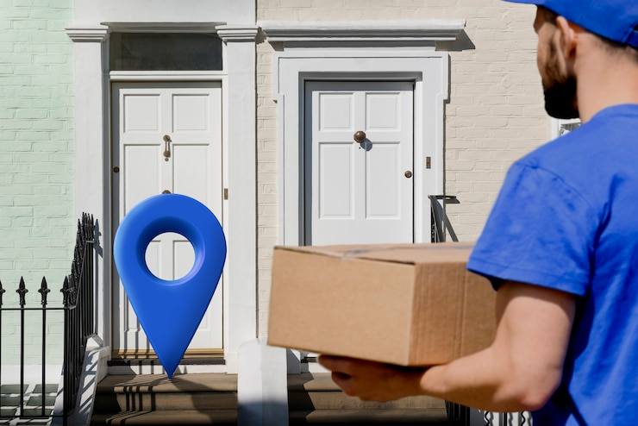
PROBLEM STATEMENT
Traditional doorstep delivery systems face two major issues:
1. Parcel Theft
2. Missed Deliveries
These issues highlight the need for a secure, reliable delivery solution that works even when the recipient is away.
Fig: Traditional Doorstep Delivery
1

Slide 4
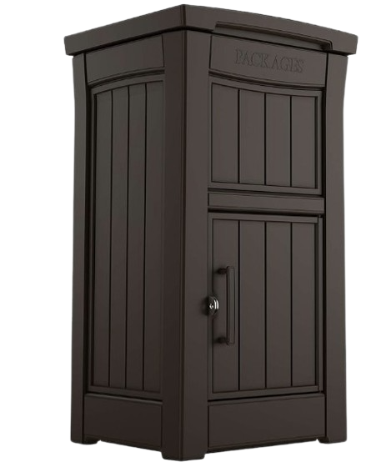
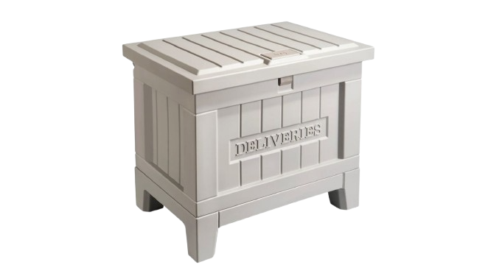
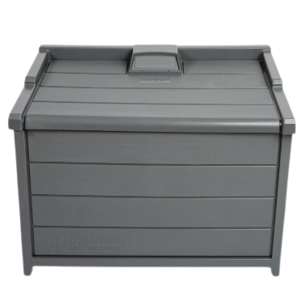
EXISTING SYSTEMS
KETER
YALE
Bench Sentry
Most existing systems like Keter, BenchSentry, and Yale have limited capacity, security issues, and are expensive, requiring manual setup and reducing convenience.
3
2

Slide 5
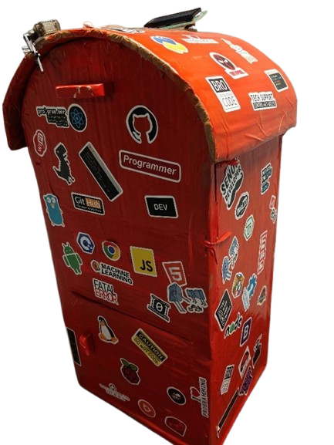
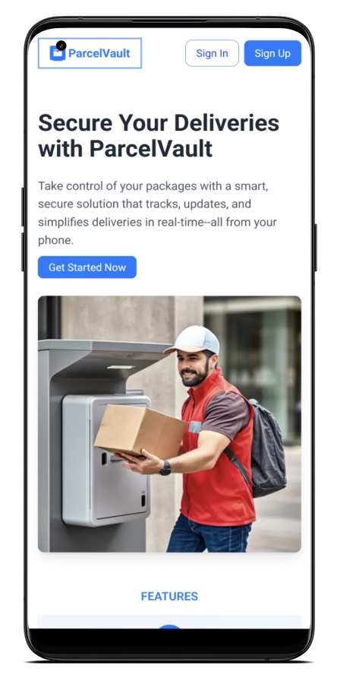





PROPOSED SYSTEM
PARCELVAULT
An IoT-enabled smart parcel box with:
Secure Access Control
Automated Package Detection
Remote Monitoring & Real-time notification
Multi-parcel Support
5
3

Slide 6
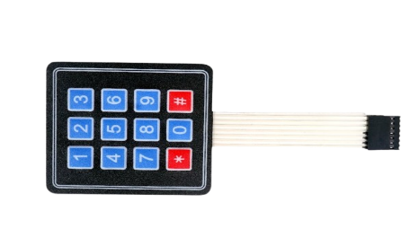
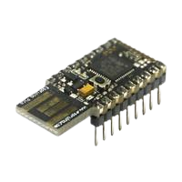
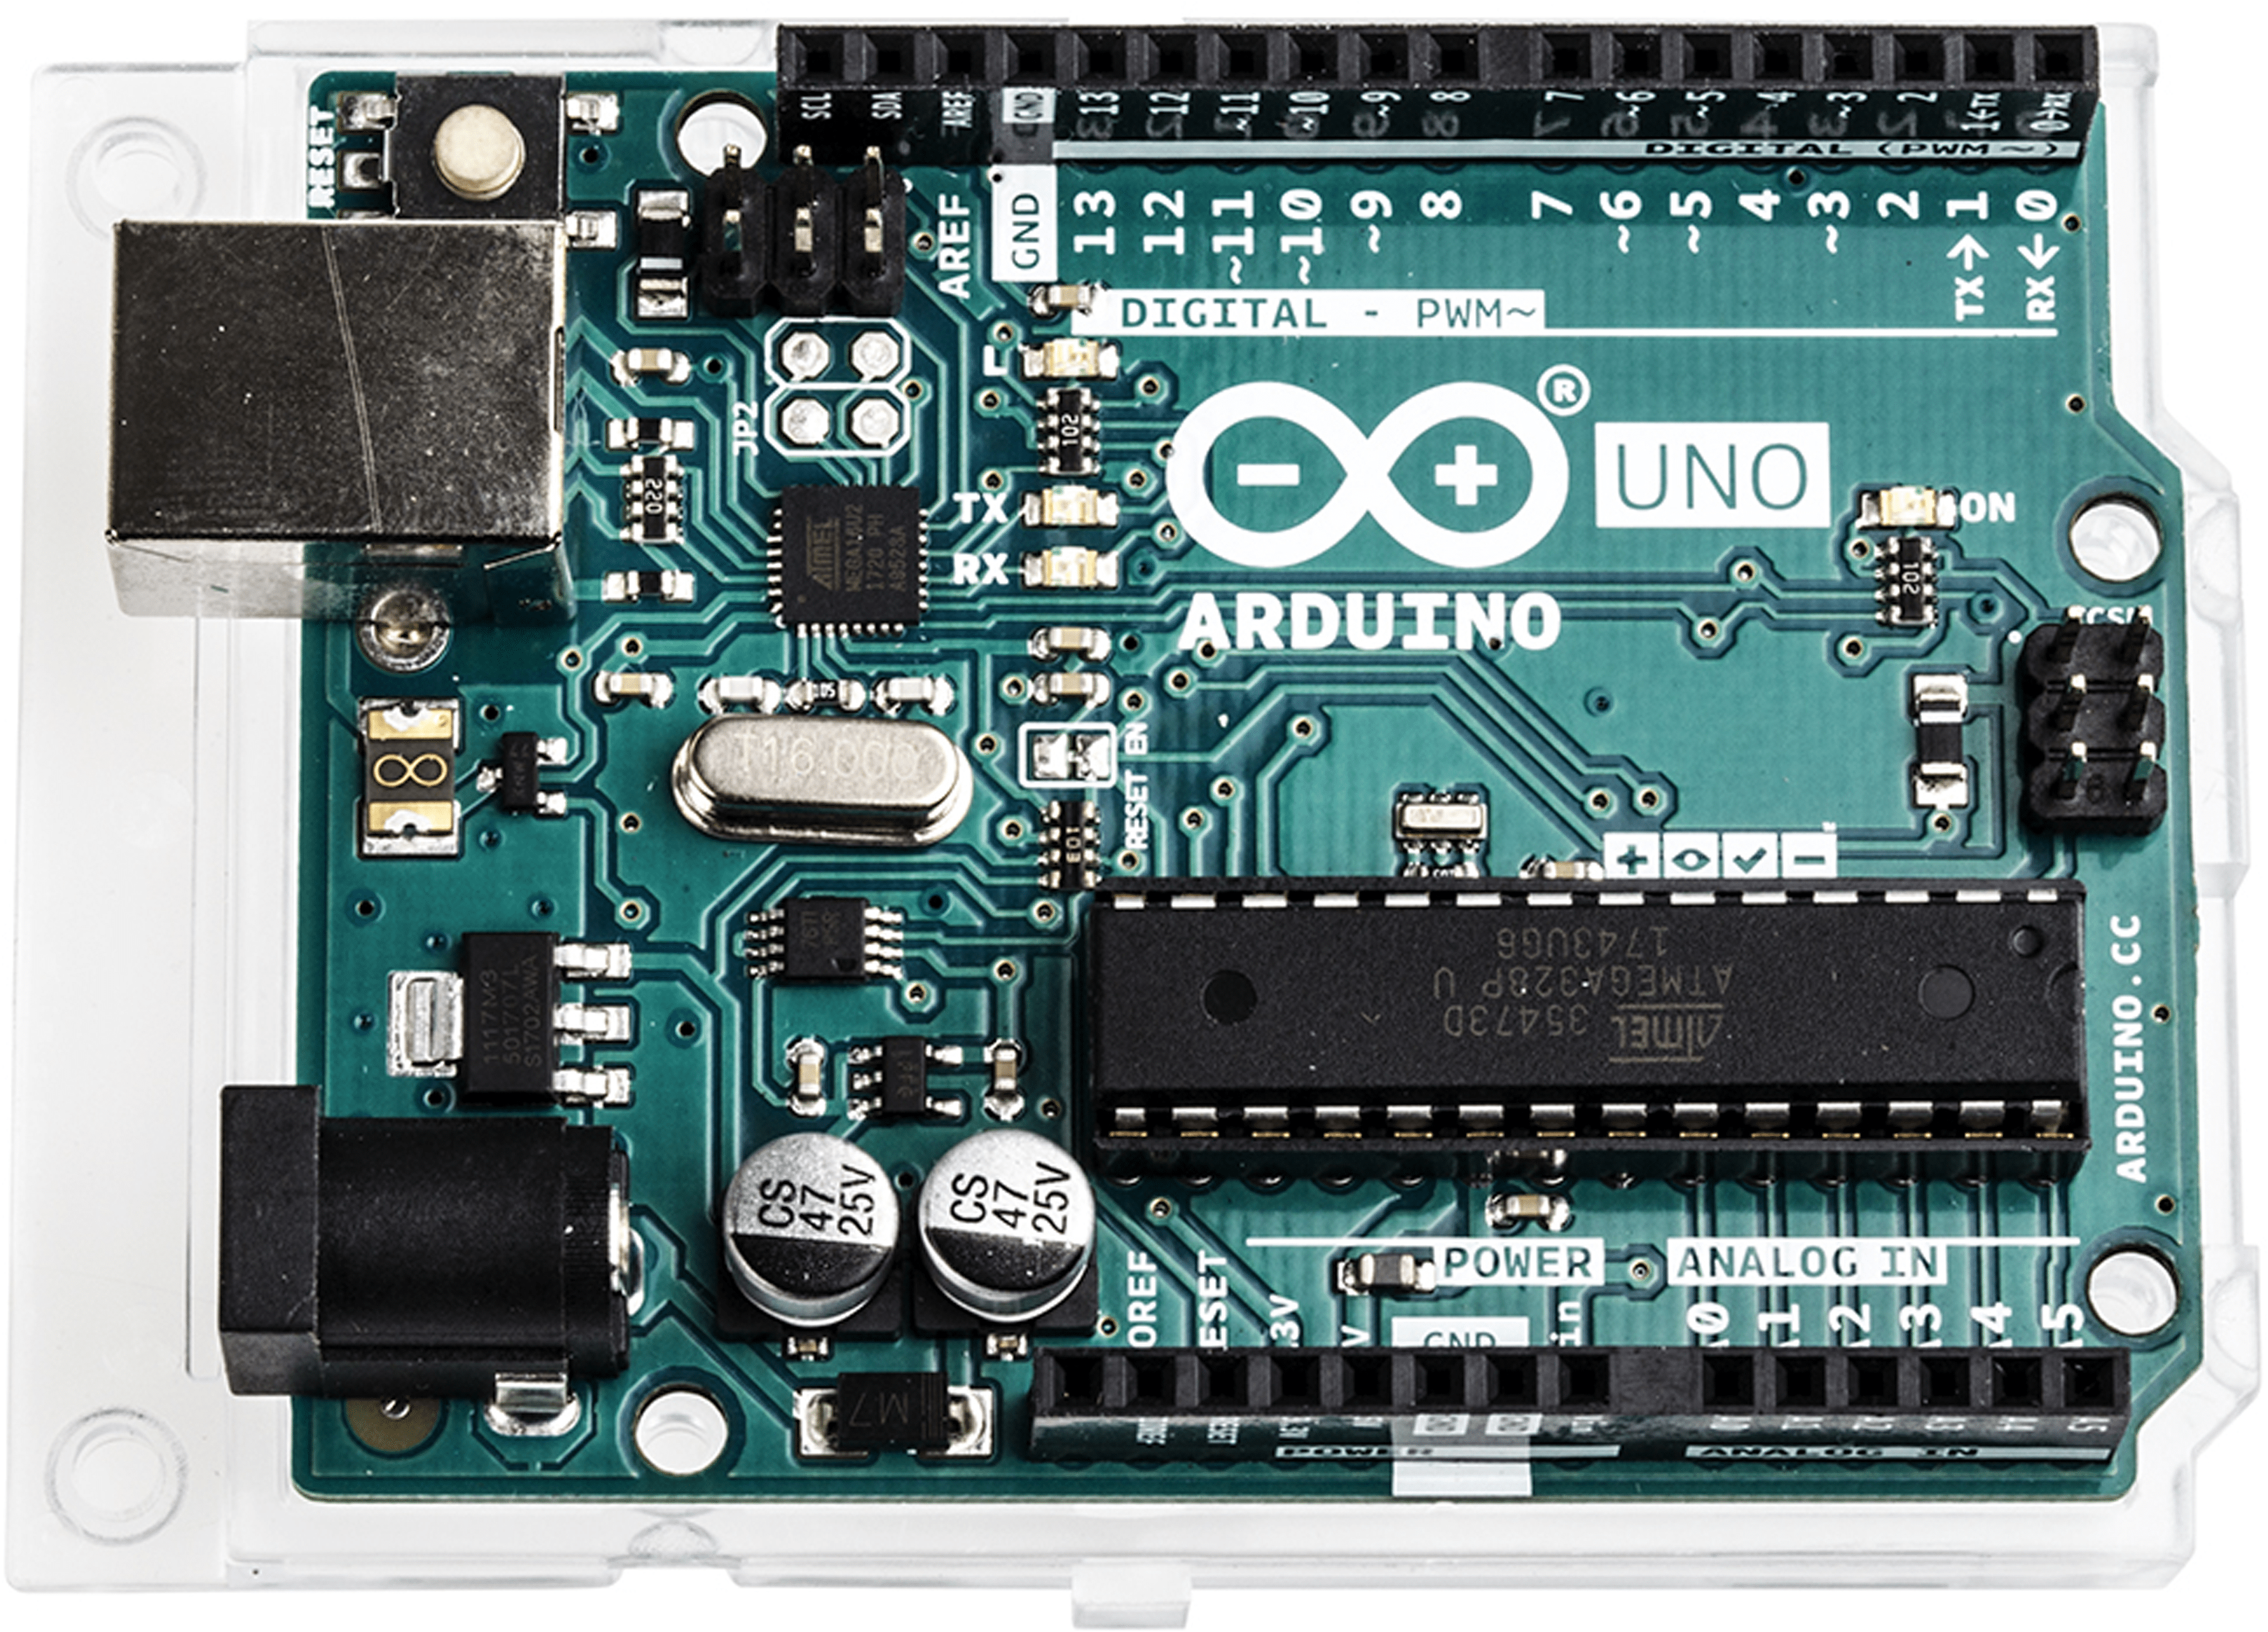
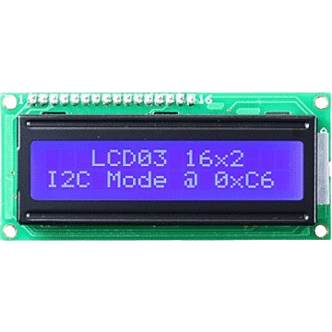

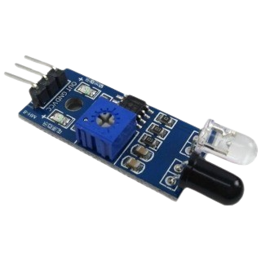
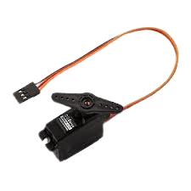
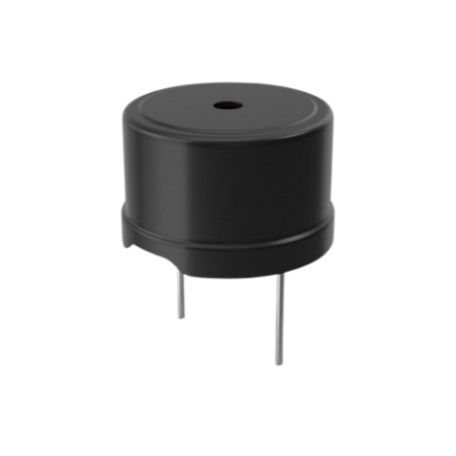
HARDWARE USED
MICROCONTROLLERs
SENSORS & ACTUATORS
PROTOCOL
WIFI MODULE
IR Sensor
Keypad
Servo Motor
LCD Display
Buzzer
HTTPS
Arduino Uno
ESP-32
6
4

Slide 7




SOFTWARE USED
FRONTEND
CLOUD/BACKEND SERVICE
Embedded Programming
Arduino
React/NextJS App
SupaBase
5
5

Slide 8
ARCHITECTURE USED
4 LAYER IOT ARCHITECTURE
PERCEPTION
NETWORK
PROCESSING
APPLICATION
7
6

Slide 9
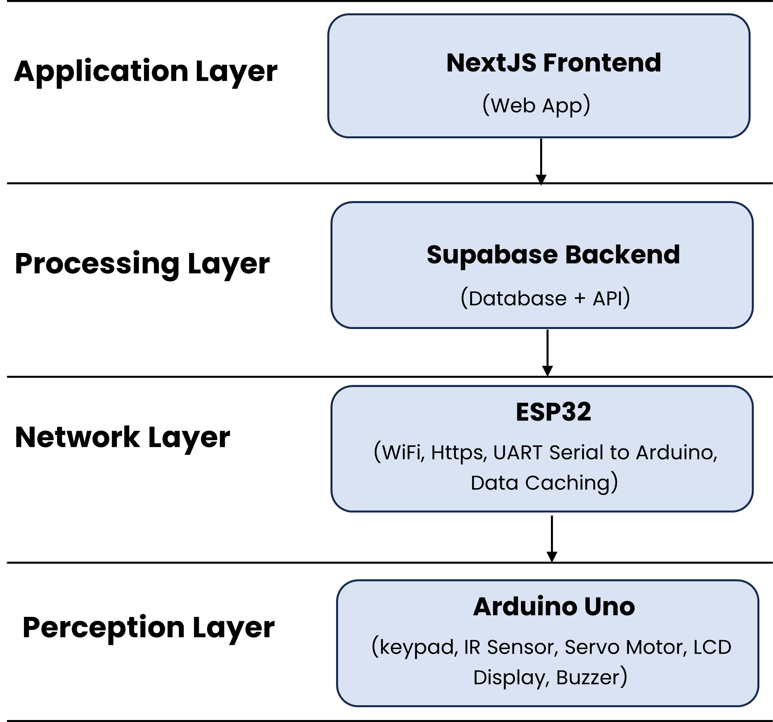
Network Layer: ESP32 – connects to Wi-Fi, talks to Arduino.
HIGH-LEVEL ARCHITECTURE
Application Layer: Includes the Next.js web app – shows status, generates OTP
Processing Layer: Houses the Supabase backed – stores data, syncs with devices.
Network Layer: Has the ESP32 – connects to Wi-Fi, talks to Arduino.
Perception Layer: Includes the Arduino – controls sensors, lock, display, alerts.
7

Slide 10
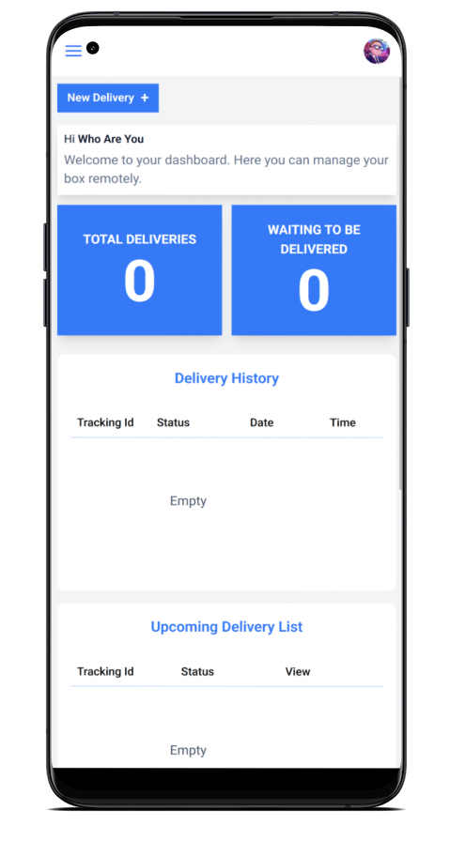
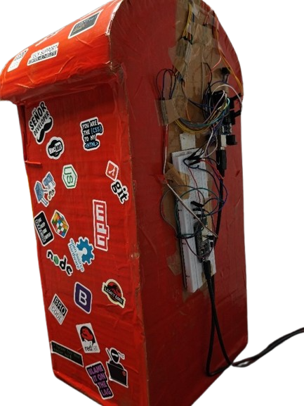
OUTCOME
An IoT smart delivery system using IR sensors for package detection, an OTP keypad for secure access, and a servo lock for automated parcel control.
A web-based app with real-time updates for users to remotely monitor parcel deliveries.
4
8

